Slide 1
Identification of new particles from LHC dataset by Machine Learning
Final Project for DSE301
Artificial Intelligence and its Application
By: Subhajit Pramanik (18398)* & Subhojit Pal (18400)**
*Department of Economic Sciences, **Department of Physics
Indian Institute of Science Education and Research, Bhopal

Slide 2
Our Goal:
In this project, we have made a model which will train a classifier to identify the type of a particle, using the datasets of particle collision at LHC. According to the responses in different tracking systems the model will identify the type of particles. In this way. If there is some particle which don’t match with any of the existing category, then that particle will be of a new type. In this way, this model will find new particles.

Slide 3
PARTICLE IDENTIFICATION
Theory

Slide 4
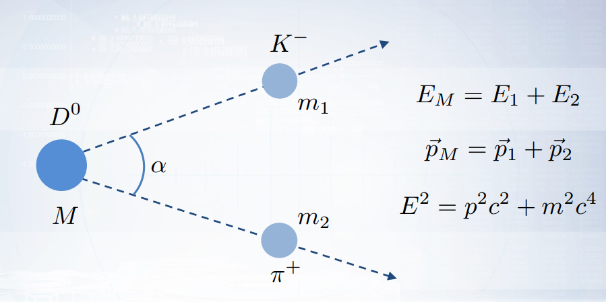
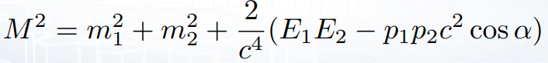
Decaying of Particle

Slide 5
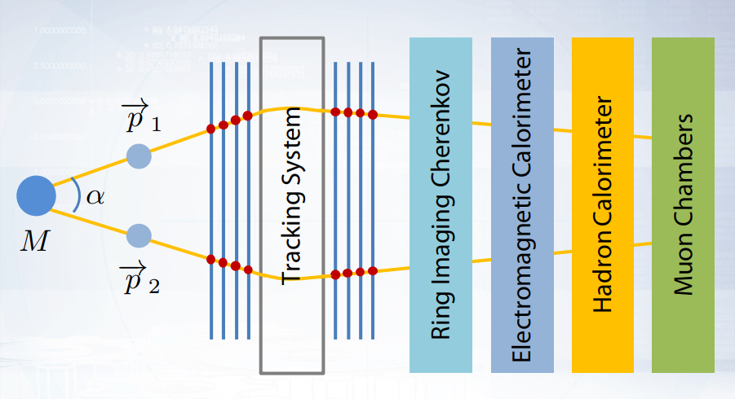
Tracking System:

Slide 6
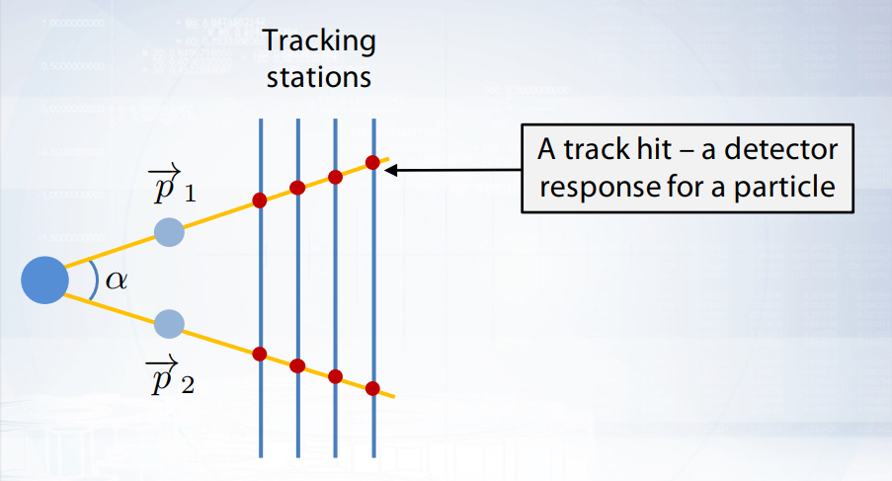
Tracking System:
Hits allows to reconstruct particle tracks and estimate α.
Track pattern recognition is recognition of particle tracks among set of hits in the detector.

Slide 7
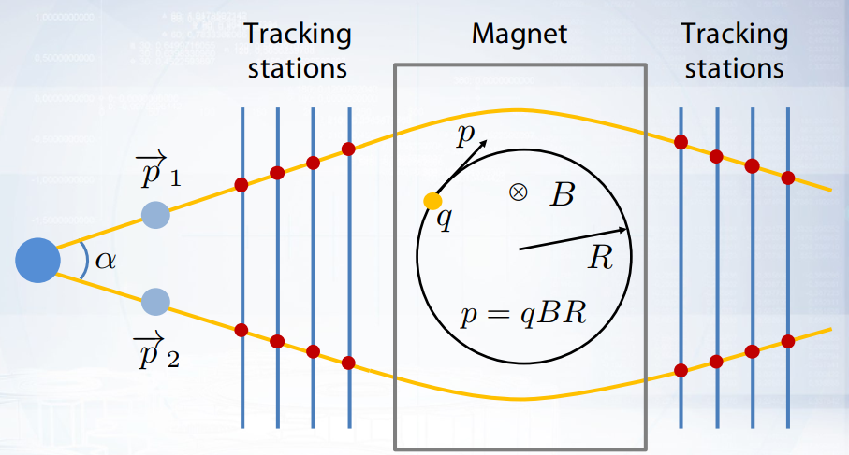
Magnetic field deflects charged particles and allows to estimate particle momentum. Tracking stations are needed to estimate the deflection.

Slide 8
Ring Imaging Cherenkov (RICH) detector

Slide 9
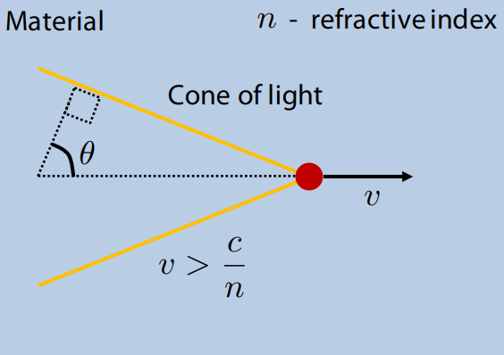
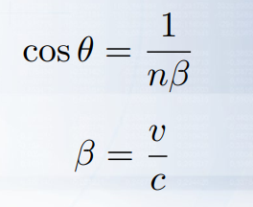
RICH detector is based on Cherenkov radiation effect:

Slide 10
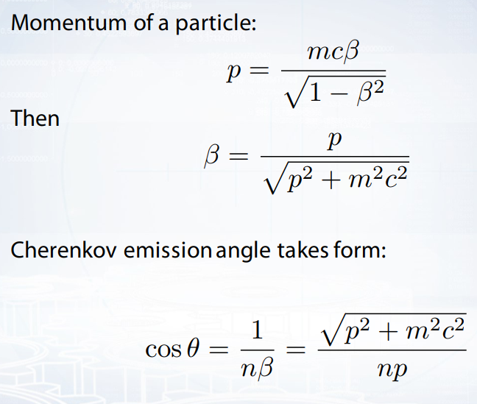

Slide 11
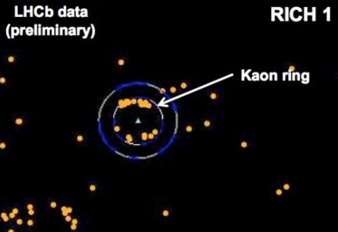
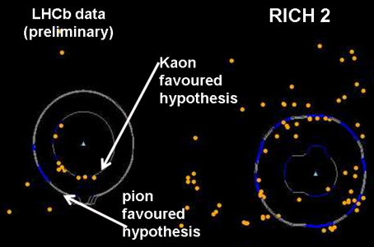
So, how it looks in the LHCb RICH detectors?
LHCb / https://inspirehep.net/record/857115/plots
LHCb / https://inspirehep.net/record/857115/plots

Slide 12
Calorimeters

Slide 13
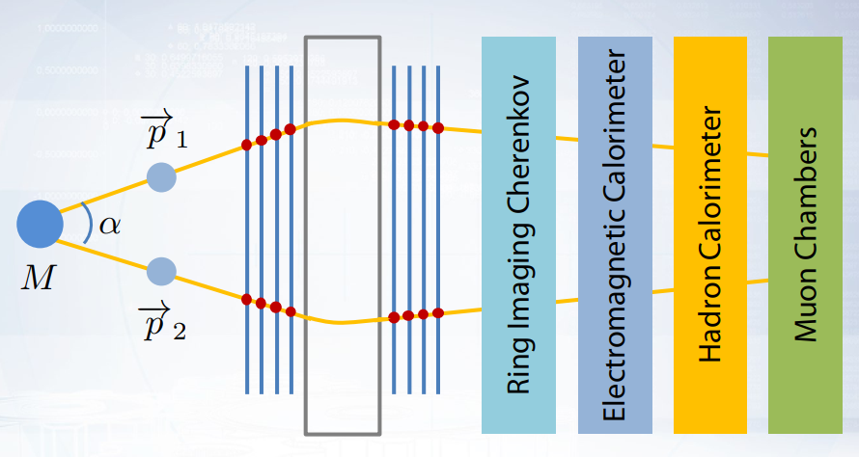
Tracking System
Subdetectors for the Particle Identification

Slide 14
The calorimeter system is designed to measure particles energy.
Particles interact with matter of the calorimeter and lose energy. The calorimeter measures how much energy the particles lose before they stop.
The electromagnetic calorimeter is responsible for measuring the energy of electrons and photons.
Interacting with matter an electron emits an photon.
Interacting with matter an phonon decays into an electron and a positron.
The process repeats creating an electromagnetic shower.

Slide 15
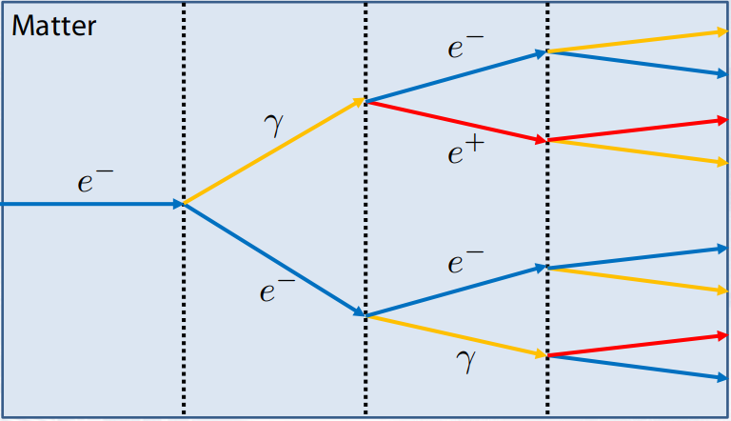
Process of Electromagnetic Shower

Slide 16
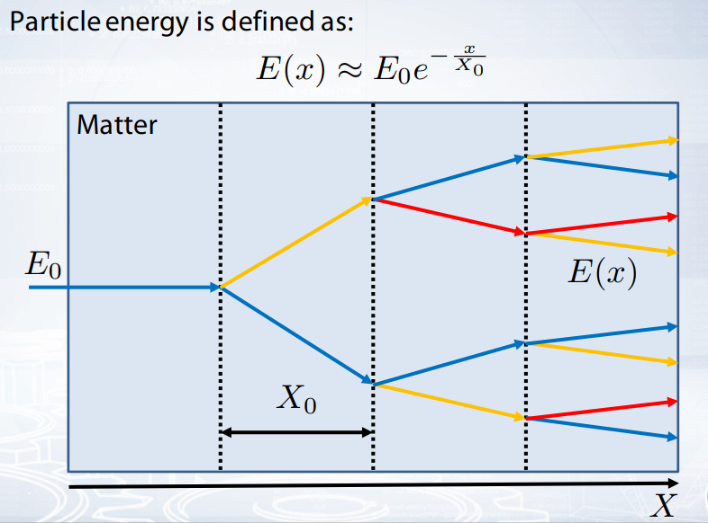

Slide 17
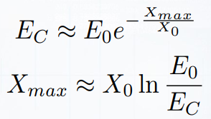
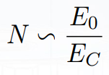

Electromagnetic shower grows while the energy of the particles is above the critical value . The shower size $X_{Max}$ can be estimated as follow:
The total number of particles in the shower is estimated as:
Measuring the number of particles allows to determine the energy of the incoming particle.

Slide 18
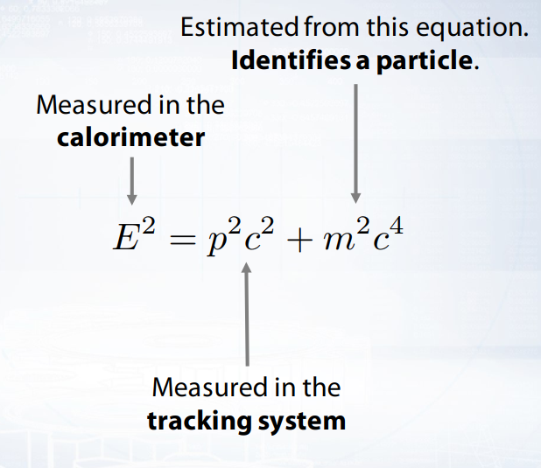

Slide 19
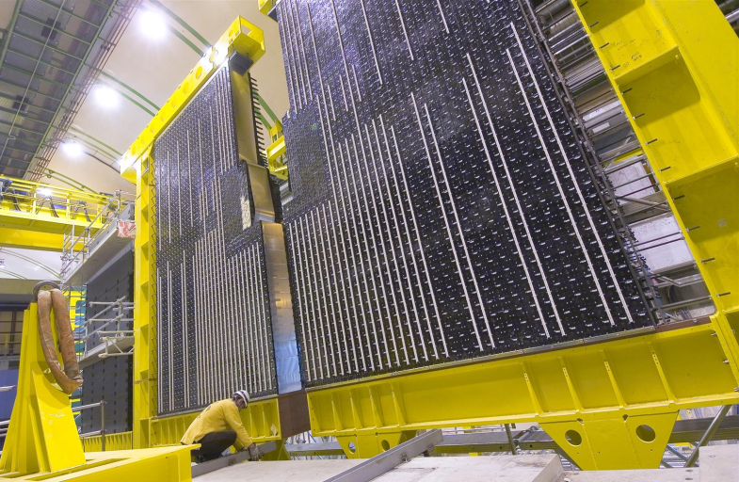
LHCb electromagnetic calorimeter:
Maximilien Brice / http://cds.cern.ch/record/835712

Slide 20
MACHINE LEARNING IN PARTICLE IDENTIFICATION

Slide 21
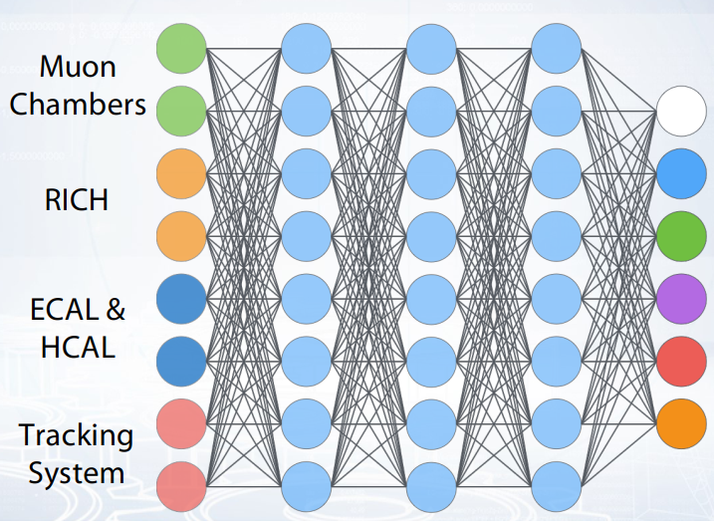
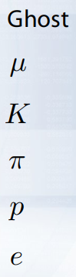
Particle identification is multiclass problem in machine learning:

Slide 22
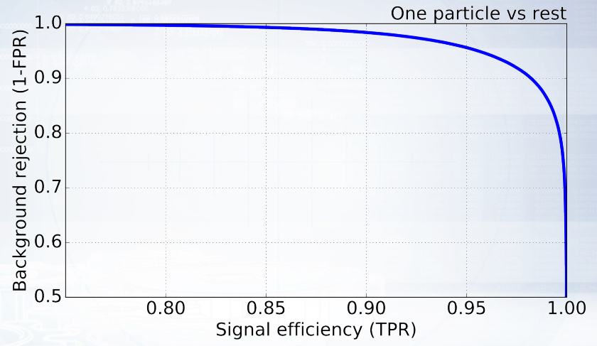
ROC Curve in PID
Typical ROC AUC values in PID are 0.90 – 0.995 depending on particle type.

Slide 23
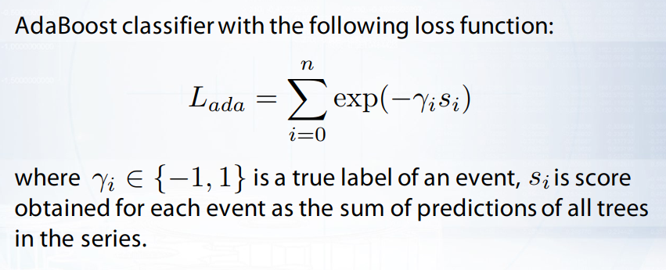
Uniform Classifiers:
Consider how to train a boosting over decision trees classifier to provide flat performance on a set of features.

Slide 24
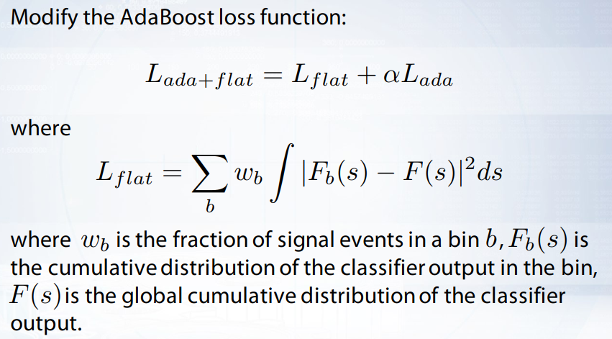


Slide 25
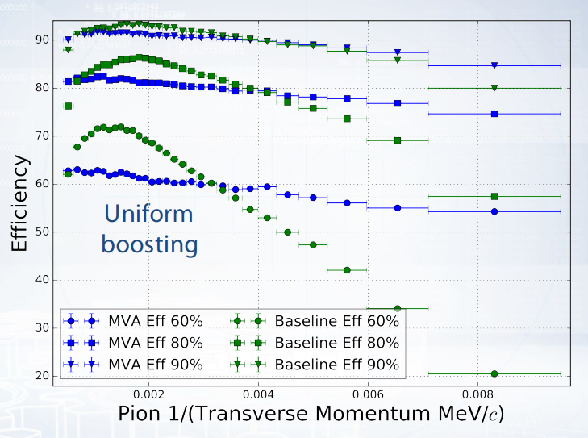
Derkach D. et. al., Machine-Learning-based global particle-identification algorithms at the LHCb experiment, ACAT 2017, Seattle, USA.

Slide 26
References:
• Marian Stahl, Machine learning and parallelism in the reconstruction of LHCb and its upgrade, Journal of Physics: Conf. Series 898 (2017) 042042, DOI:10.1088/1742-6596/898/4/042042 • Calvo M. et al., A tool for γ/π0 separation at high energies, LHCb-PUB-2015-016, https://cds.cern.ch/record/2042173 • Checalina V. et al., Machine Learning Photons Separation in the LHCb Calorimeter, ACAT2017, https://indico.cern.ch/event/567550/contributions/2638699/ • LHCb collaboration, Identification of beauty and charm quark jets at LHCb, JINST 10 (2015) P06013, DOI:10.1088/1748-0221/10/06/P06013 • Gligorov, Vladimir V et al., The HLT inclusive B triggers, LHCb-PUB-2011-016, https://cds.cern.ch/record/1384380 • Borisyak M. et. al., Towards automation of data quality system for CERN CMS experiment, DOI:10.1088/1742-6596/898/9/092041 • De Cian, Michel et al., Fast neural-net based fake track rejection in the LHCb reconstruction, LHCb-PUB-2017-011, https://cds.cern.ch/record/2255039 • Farrell S. et al., The HEP.TrkX Project: deep neural networks for HL-LHC online and offline tracking, EPJ Web Conf. Volume 150, 2017, DOI: https://doi.org/10.1051/epjconf/201715000003

Slide 27
Thank You

